Slide 1
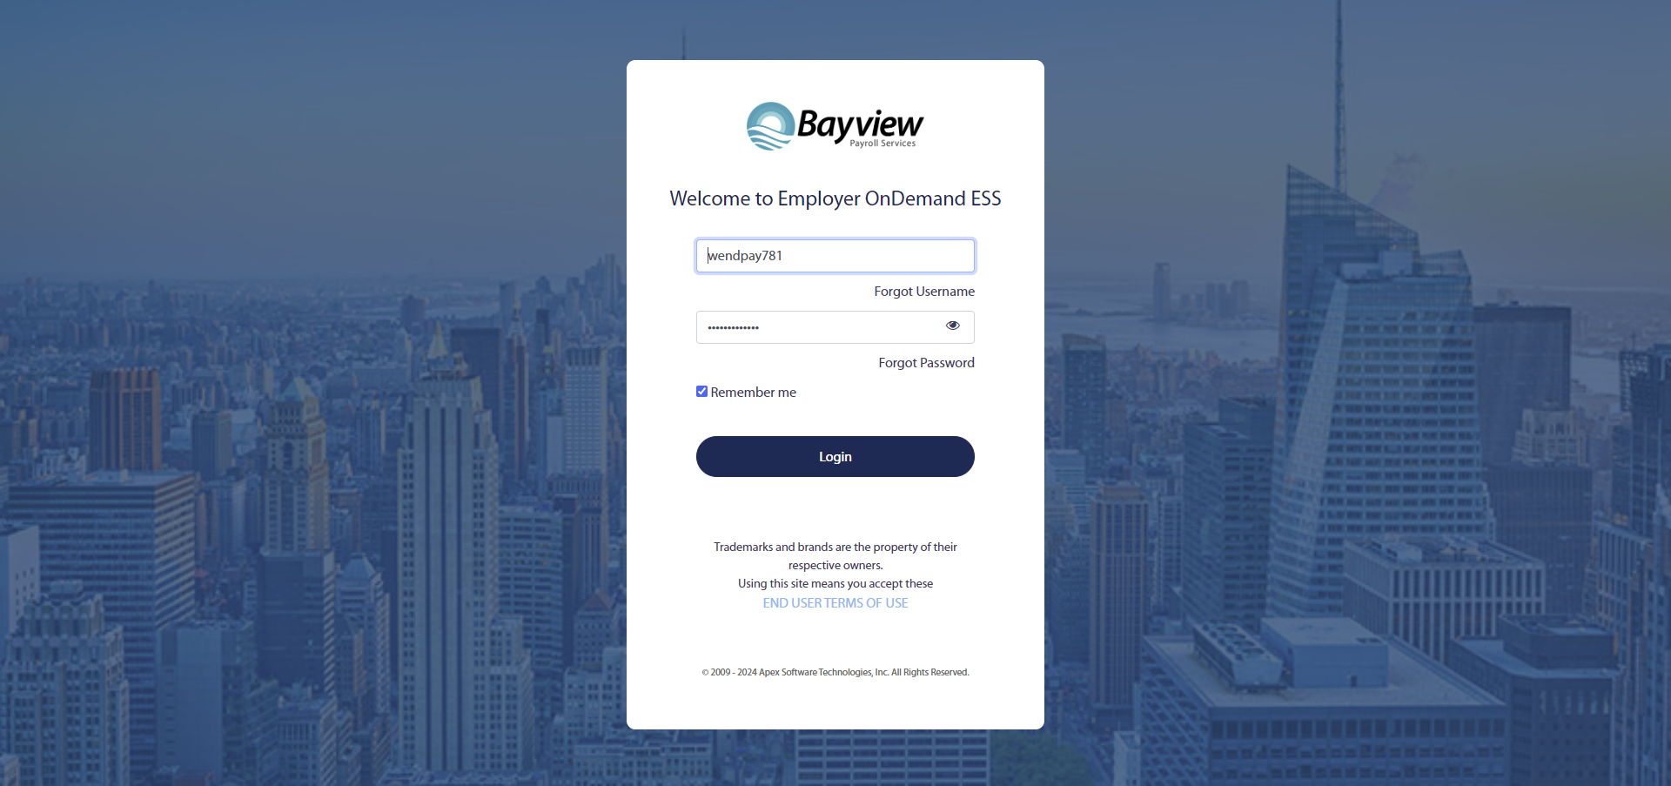
How to reset your password for Employer On Demand ESS
Go to URL/Link: https://selfservice.employerondemand.com/?PL=20171358
In the main page Type your username and click “Forgot Password”.

Slide 2
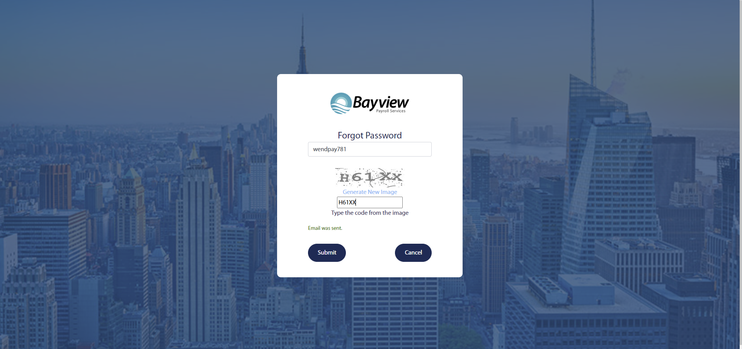
Type your username again and then type the characters you see in the box below.
Then click “Submit”.
An email will be sent with a link to reset your Password.

Slide 3
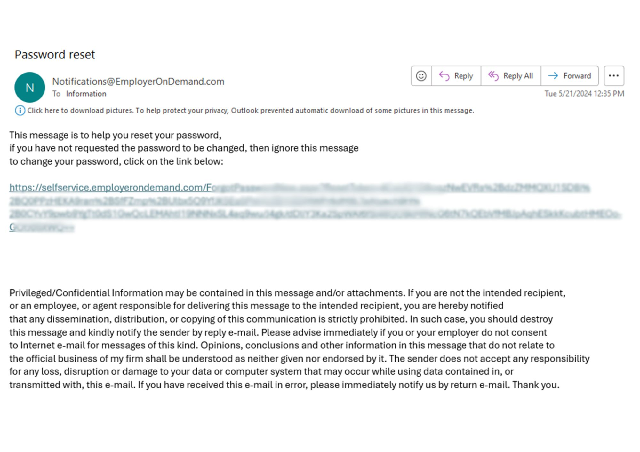
Click on the link on the email sent by the system. This will take you to a password page.

Slide 4
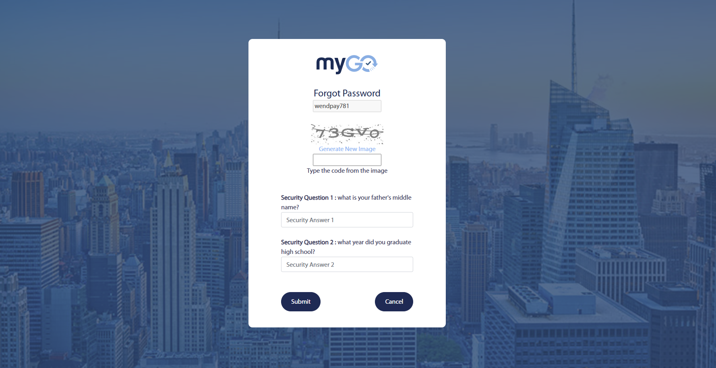
Type your username again and the characters you see on top.
Then answer the security questions that had been previously selected by you.
Click “Submit”

Slide 5
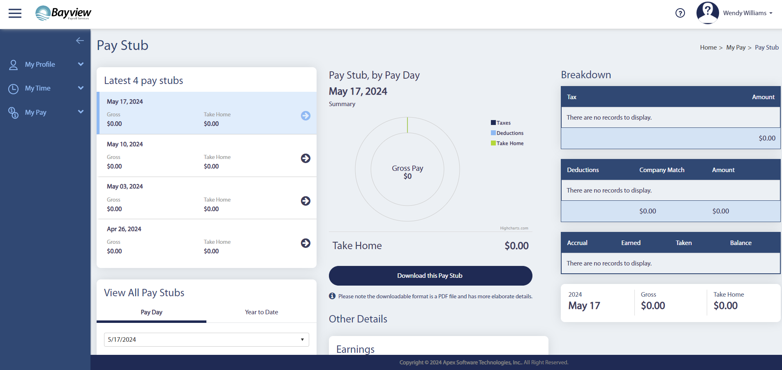
This will take you to the main page of your Profile where you can view, download or print your paystubs.

